Slide 1
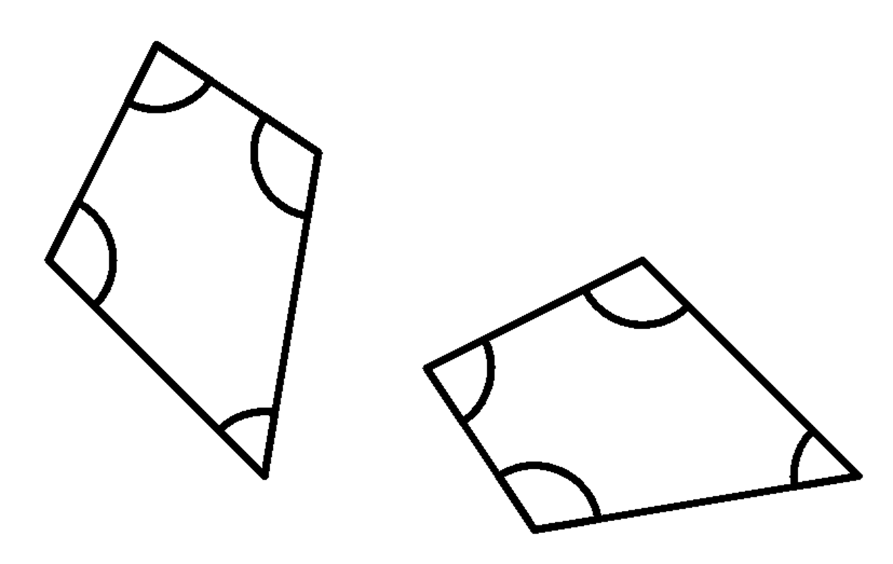
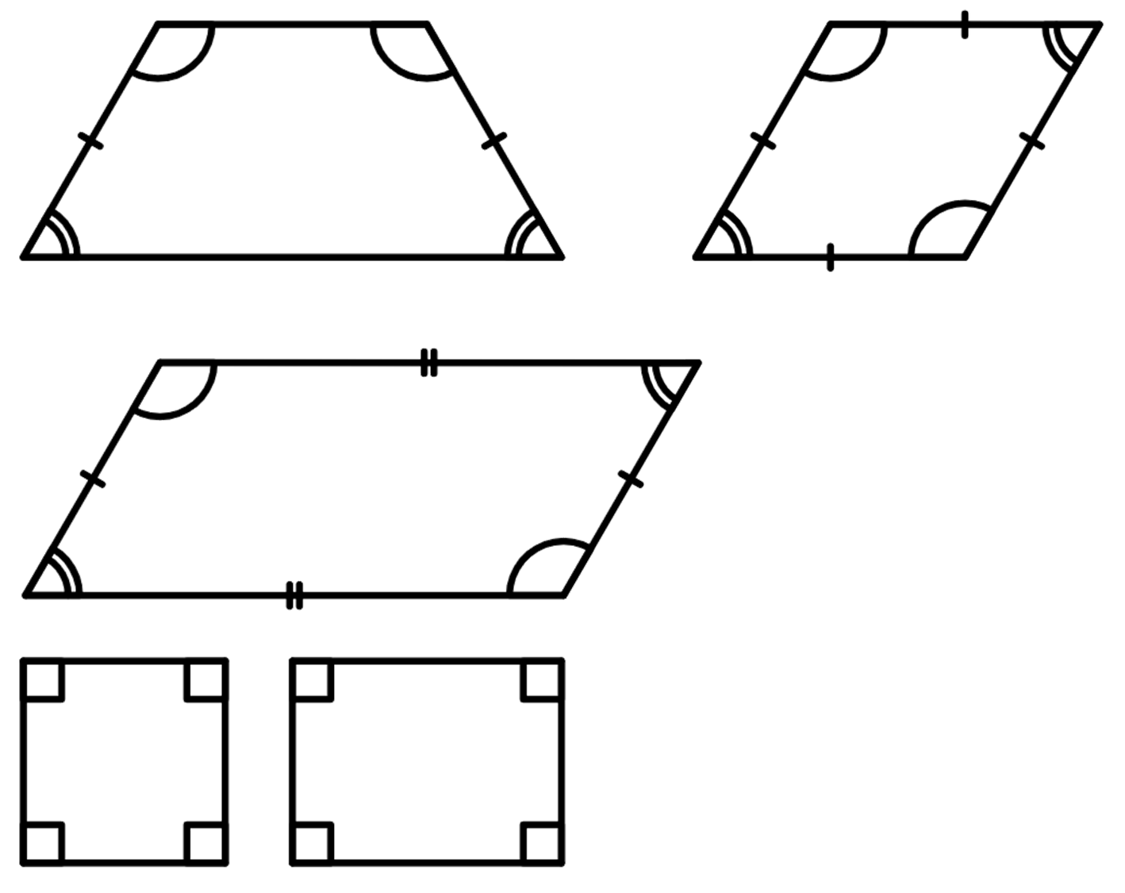
Congruent triangles (SSS)
Task A: Guaranteeing congruence
1) These two quadrilaterals are congruent. Fill in the blanks.
3.6 cm
4.5 cm
4.5 cm
83°
5.7 cm
114°
83°
108°
108°
55°
3.6 cm
114°
5.7 cm
55°
6.1 cm
6.1 cm
2) Give an example of quadrilaterals that show that these conditions are not sufficient to prove congruence.
a) angles are the same
An isosceles trapezium and a parallelogram can have the same angles but they are not congruent.
120°
120°
60°
60°
b) angles are the same and in the same order
Squares and rectangles have four right angles but are not congruent.
Parallelograms and rhombi can have the same angles in the same order but are not congruent.
120°
120°
60°
60°

Slide 2
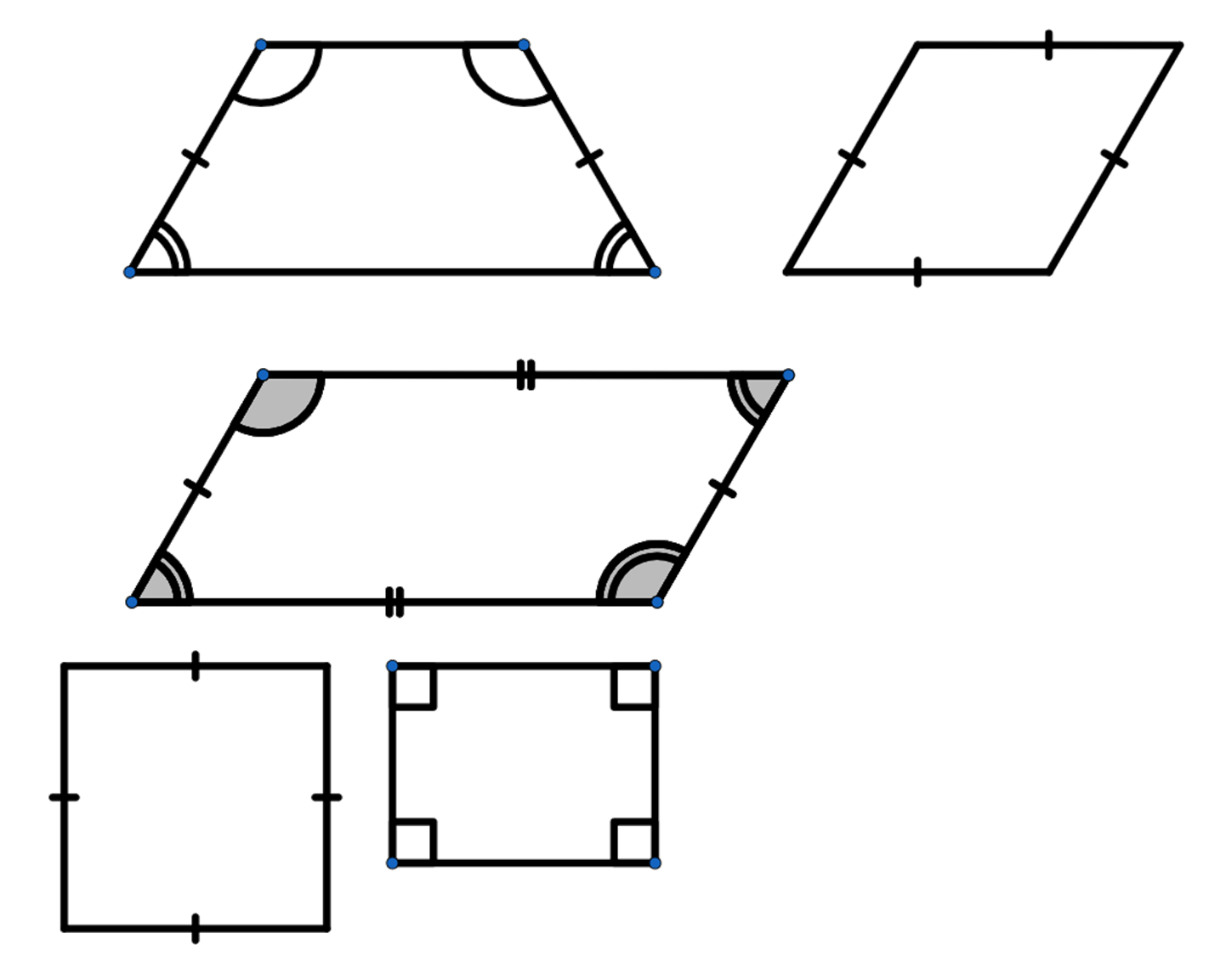
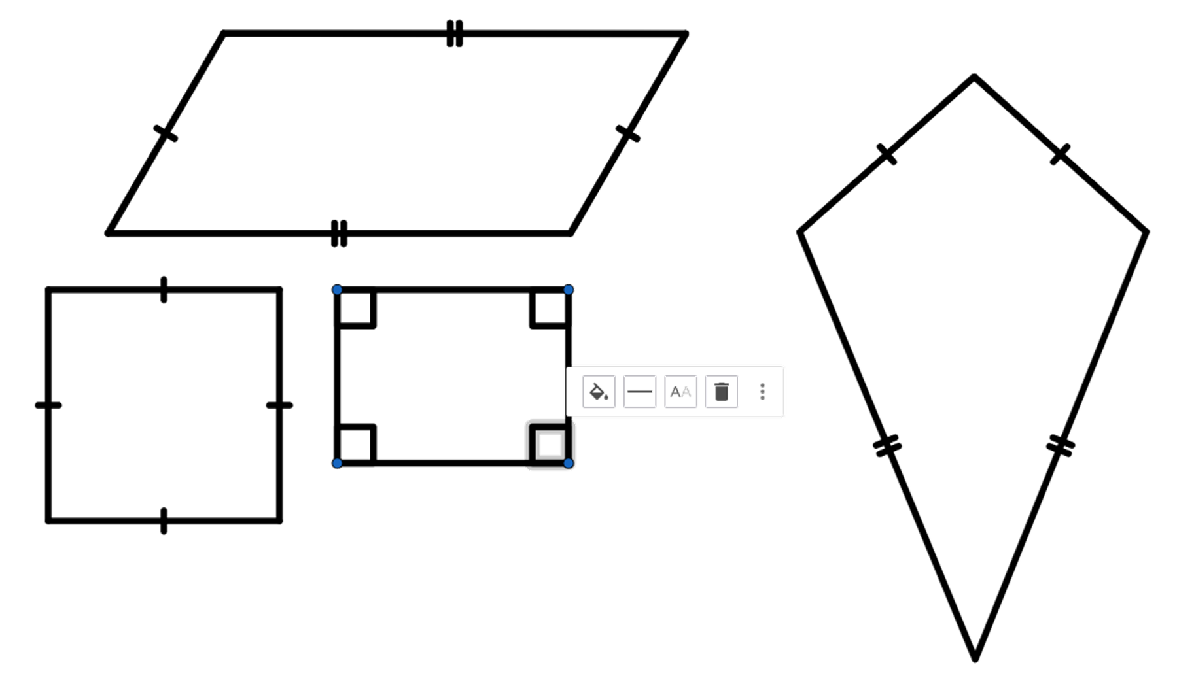
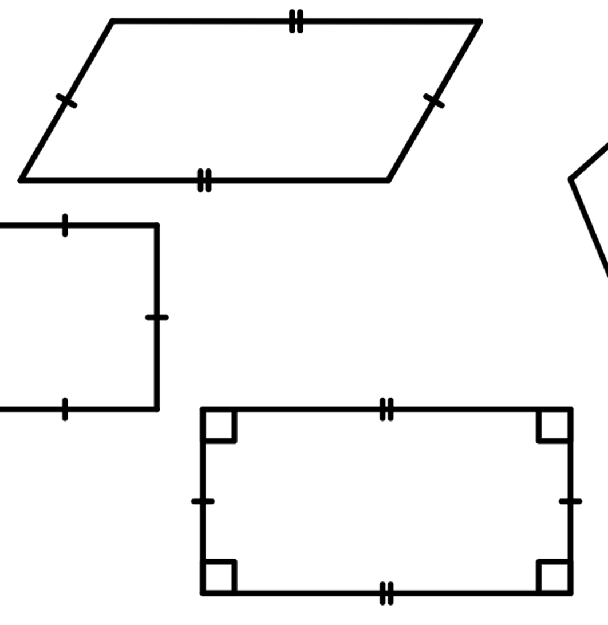
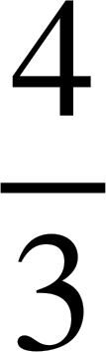
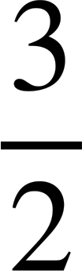
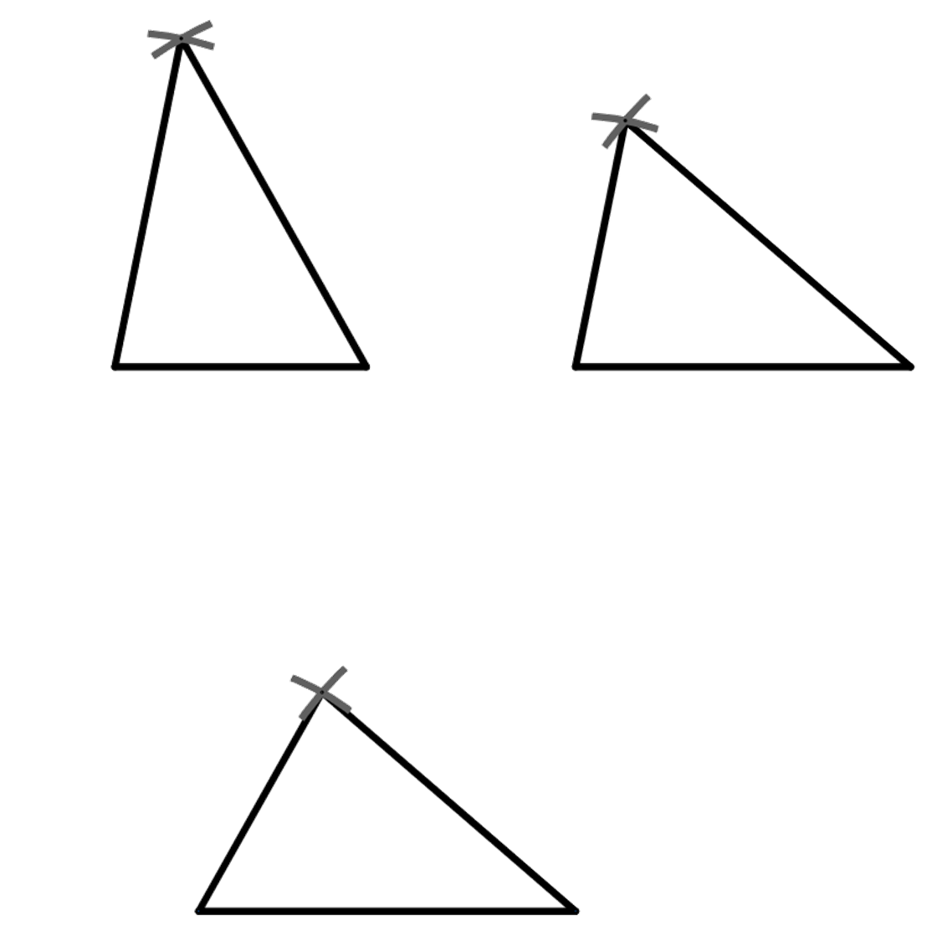
Congruent triangles (SSS)
c) edges are the same length
Squares and rhombi can have the same edge lengths but are not congruent.
Kites and parallelograms can have the same lengths but are not congruent.
d) edges are the same length and in the same order
Rectangles and parallelograms can have the same edge lengths in the same order but are not congruent.
3) The triangle ABC, where AB = x cm, AC = x cm and BC = x cm has been constructed three times,
C
Protractors are only accurate to the nearest degree, so your answer should be around this given value
40.8°
B
A
60.6°
78.6°
78.6°
60.6°
78.6°
60.6°
A
B
A
40.8°
C
B
40.8°
C
a) measure the angles ABC, BAC and BCA in each of the three triangles
b) what do you notice?
The angles are the same in each construction.

Slide 3
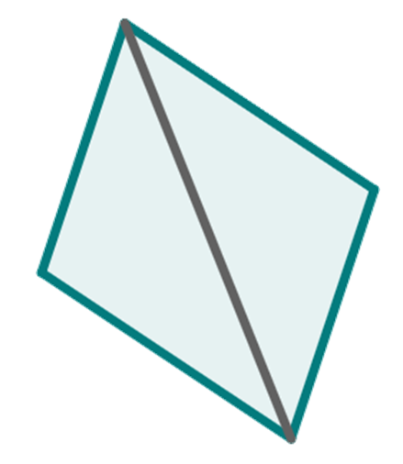
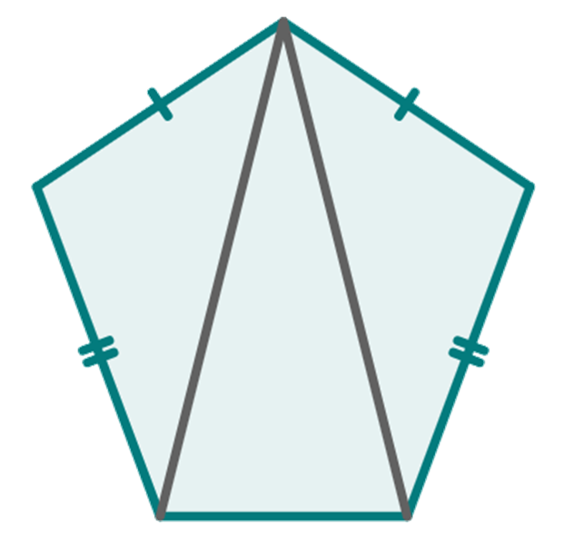
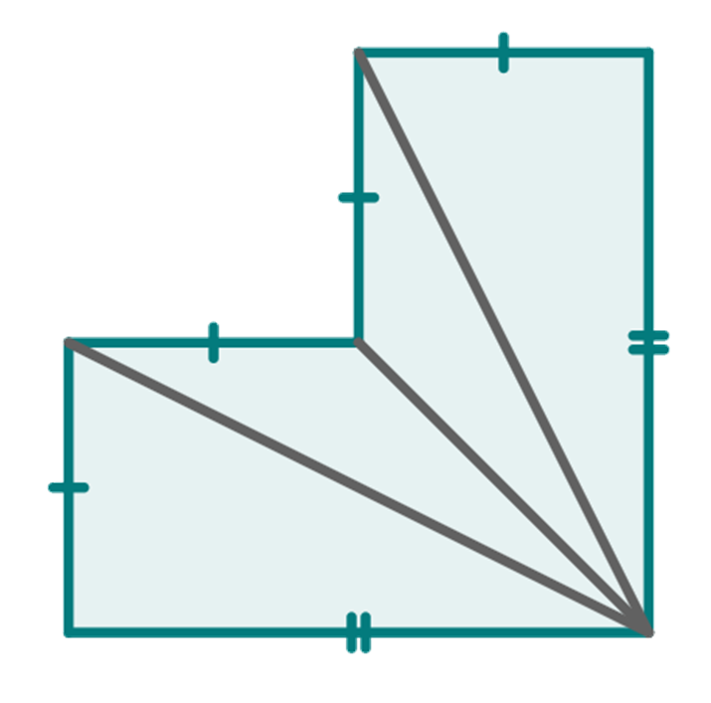
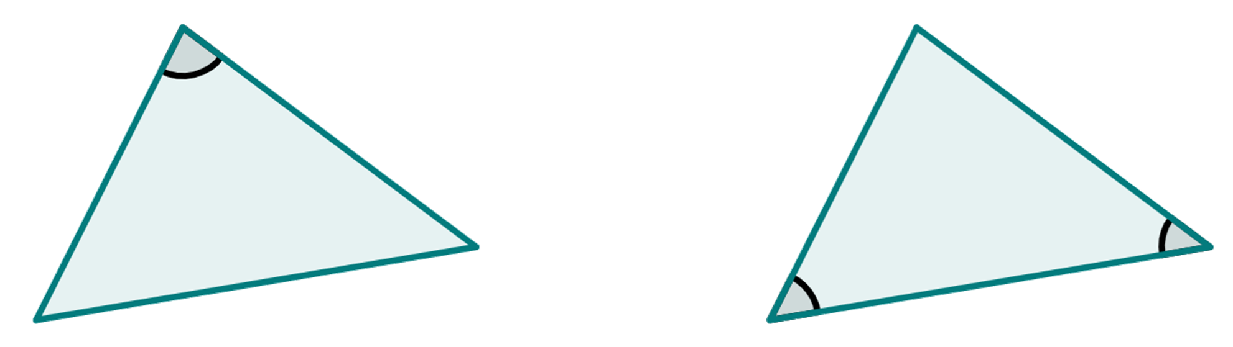
Congruent triangles (SSS)
Task B: Justifying congruence by SSS
1) By measuring the sides of these pair of triangles, decide if they are congruent or not.
A
Z
a)
They are congruent.
C
Y
B
X
b)
P
V
R
T
Q
They are not congruent.
U
2) By using properties of shapes, identify the triangles that are congruent by SSS.
a)
A
b)
T
c)
M
L
D
P
S
I
N
B
Q
R
J
K
C
symmetrical pentagon
symmetrical hexagon
parallelogram
⃤ ABC ≅ ⃤ ADC
⃤ TPQ ≅ ⃤ TSR
⃤ IJK ≅ ⃤ MLK
⃤ INK ≅ ⃤ MNK
3) These pairs of triangles are congruent. Using this fact, add the edge length marked x.
80°
5 cm
4.5 cm
46°
54°
6.1 cm
6.1 cm
Mathematics in Education and Industry
v2.3

